Slide 1




[Insert Survey QR Code]
OR
[Insert Survey URL and passcode]
In one or two words, what does belonging mean to you?
Notes:
Good Morning and Happy Spring! Welcome Back to the 3rd session of our Full Stack Wellness and Inclusion Series, again we're so happy that you've joined us today. Before we get started, we'd like to hear from you on our opening question. I'll hand it over to Jeff and Joanna.

Slide 2

Session 3: Developing a Team Where Everyone Belongs
Full Stack Wellness & Inclusion Series
Notes:
Erin Thank – Welcome back to the Full Stack Wellness & Inclusion Series. Today's topic will be on Designing a Team Where Everyone Belong . The session will highlight the value of proximity and a culture of belonging where we can express who we are.

Slide 3





Session 3: Belonging
What (are we going to deliver)?
Developing a team where everyone belongs
How to create inclusive teams where we respect each other's boundaries, needs, and priorities.
Self Actualization Needs
Esteem Needs
Love/Belonging Needs
Physiological Needs
Safety Needs
Why (is this session important)?
To highlight the value of proximity and create a culture of belonging where we can express who we are.
Story
[Team] perspectives of belonging to a team
Who (are we going to invite)?
<Insert appropriate group from your organization>
Post-event Activity
[Plan Local Satellite Events and Virtual Get Togethers]
Notes:
Erin
- In our last session, we focused on safety and Designing a team where everyone feels safe. Our speaker, Karen McDonald, Director in OneX, discussed psychological safety in terms of microaggressions, understanding what it feels like and what it should not feel like and ways to promote safety. Today, we want to move up to the next level of the pyramid to Belonging and the value of belonging in the workplace.
-So, what are we going to deliver today? We will discuss how to create inclusive teams where we respect each other's boundaries, needs and priorities.
This session is important because we want to highlight the value of proximity and create a culture of belonging where were can express who we are.
- We'll hear from a few DevRel team members and their perspectives of belonging to a team
- Paul Zimmerman will share how the Developer Experience team fosters belonging within the Developer Community.
- We are happy to have Hannah Wiley from People & Communities here today
- And Ryan will share the Post-event activity with you

Slide 4
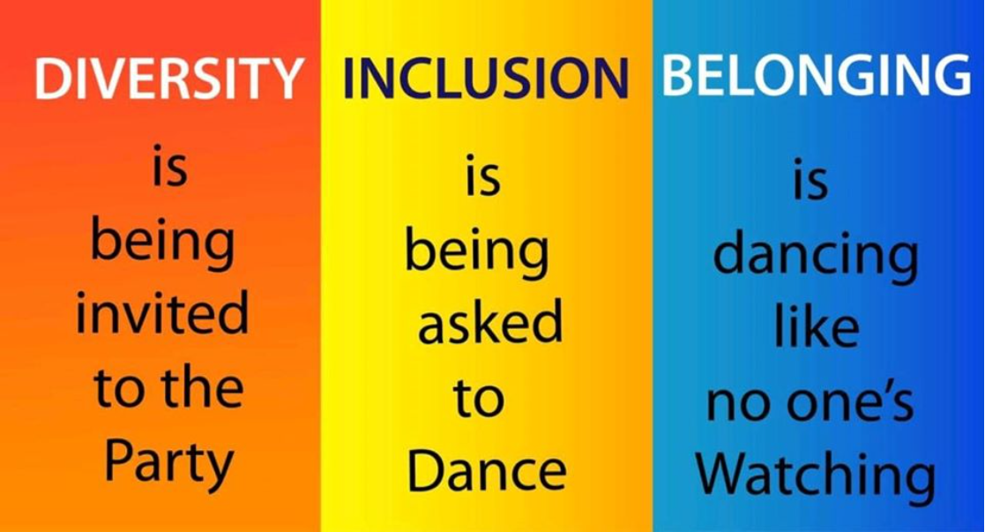
Verna Myers, Diversity and Inclusion Expert
Notes:
Belonging fosters team collaboration
According to a Harvard Business Review article, The value of Belonging at Work, Belonging is good for business. If workers feel like they belong, companies reap substantial bottom-line benefits.
The article also states "Social belonging is a fundamental human need, hardwired into our DNA. And yet, 40% of people say that they feel isolated at work, and the result has been lower organizational commitment and engagement. In a nutshell, companies are blowing it. U.S. businesses spend nearly 8 billion dollars each year on diversity and inclusion (D&I) trainings that miss the mark because they neglect our need to feel included."
We do not want to miss the mark within DevRel and Cisco. In my opinion, I think Cisco is doing well, since it continues to be the "#1 Best Places to work"
As we promote Diversity and Inclusion in this series, I'd like share this quote by Verna Myers, D&I Expert, "Diversity is being invited to the Party, Inclusion is being asked to dance and Belonging is dancing like no one's watching."
I'll now pass it over to Paul, who facilitate "Our DevRel Story"

Slide 5
Our DevRel Story
[Team] members share perspectives of belonging as a:
Quick story on background
Tell your story of how you came to be in DevRel
Where you before? –
Insightful incident - What brought you here?
And What did find?

Slide 6
Conversation with the team
Let’s Talk about Belonging!

Slide 7

Create a Spirit of Belonging
Question:
What is organization doing well to create a feeling of belonging?
[Insert Survey QR Code]
OR
[Insert Survey URL and passcode]

Slide 8
Create a Spirit of Belonging
Question:
If you could change one thing about our culture, what would it be?
[Insert Survey QR Code]
OR
[Insert Survey URL and passcode]

Slide 9
[Showcase how your team builds belonging in Business Unit]
Notes:
Thank you, Paul, Joanna, Mel, Amanda, and Adrienne. We’ll now hear from Paul who will share how the Developer Experience team fosters belonging within the Developer Community.
The importance of fostering belonging both in the internal and external community

Slide 10
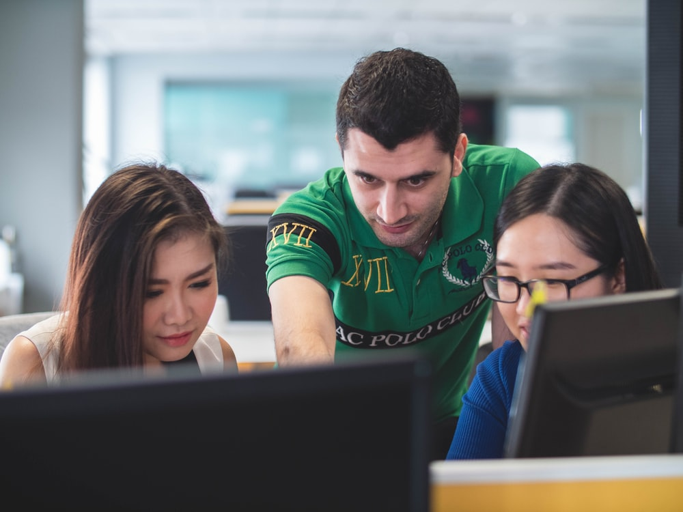
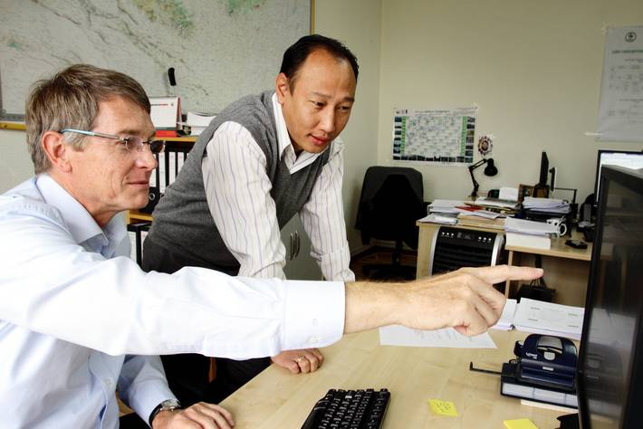
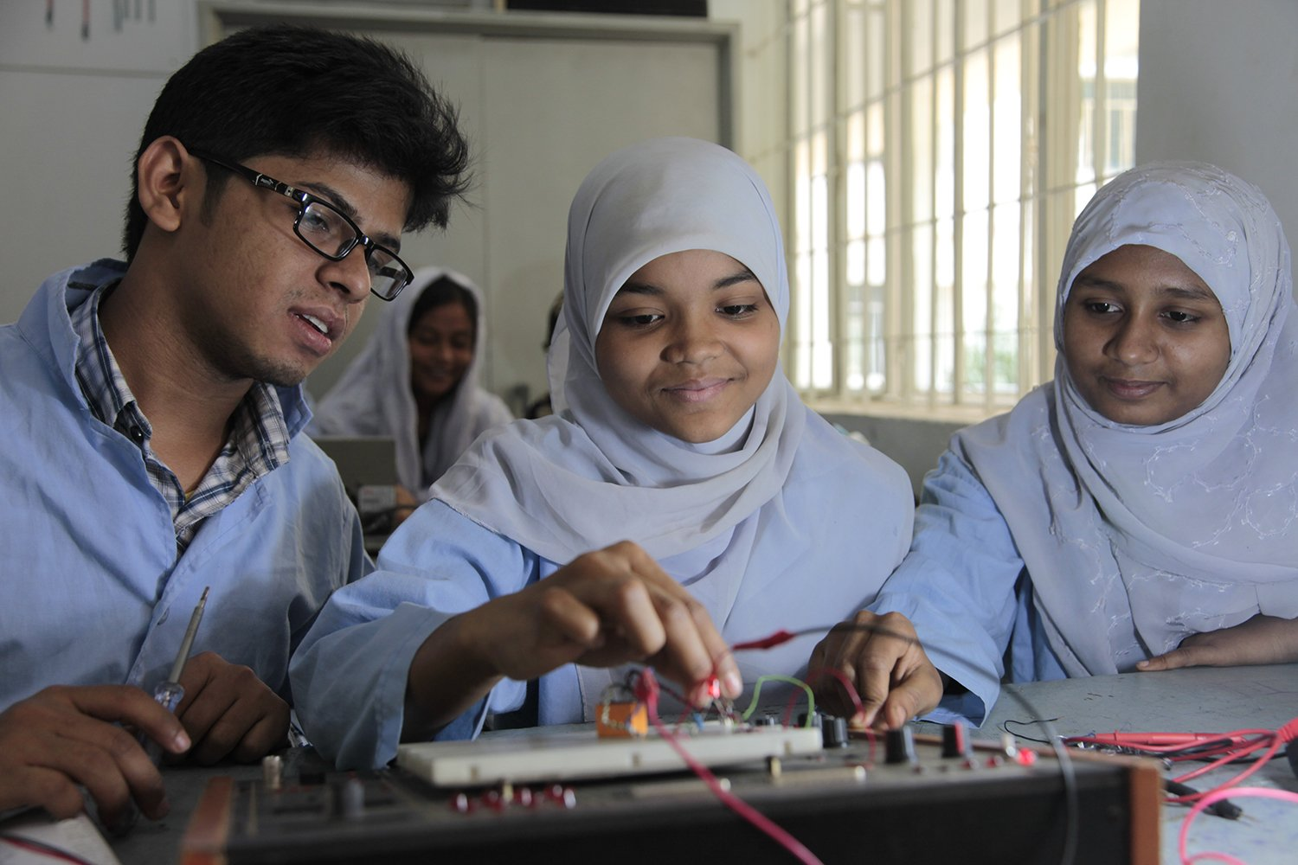
Diverse communities build more dynamic conversations
Geographic experiences
Experience levels
Cultural dimensions
Notes:
Experience level
Students to SMEs, many newbies asking questions, need the voice of experience to help find answers
Geographic experiences
Different infrastructure impacts, climate situations, availability of services
Cultural synergies (look at Hofstede scale)
- Dimensions of culture, like the Hofstede scale. Differences in how people look at the teams (individual vs collective), relationship with management and clients (power distance), competitiveness and risk tolerance.

Slide 11
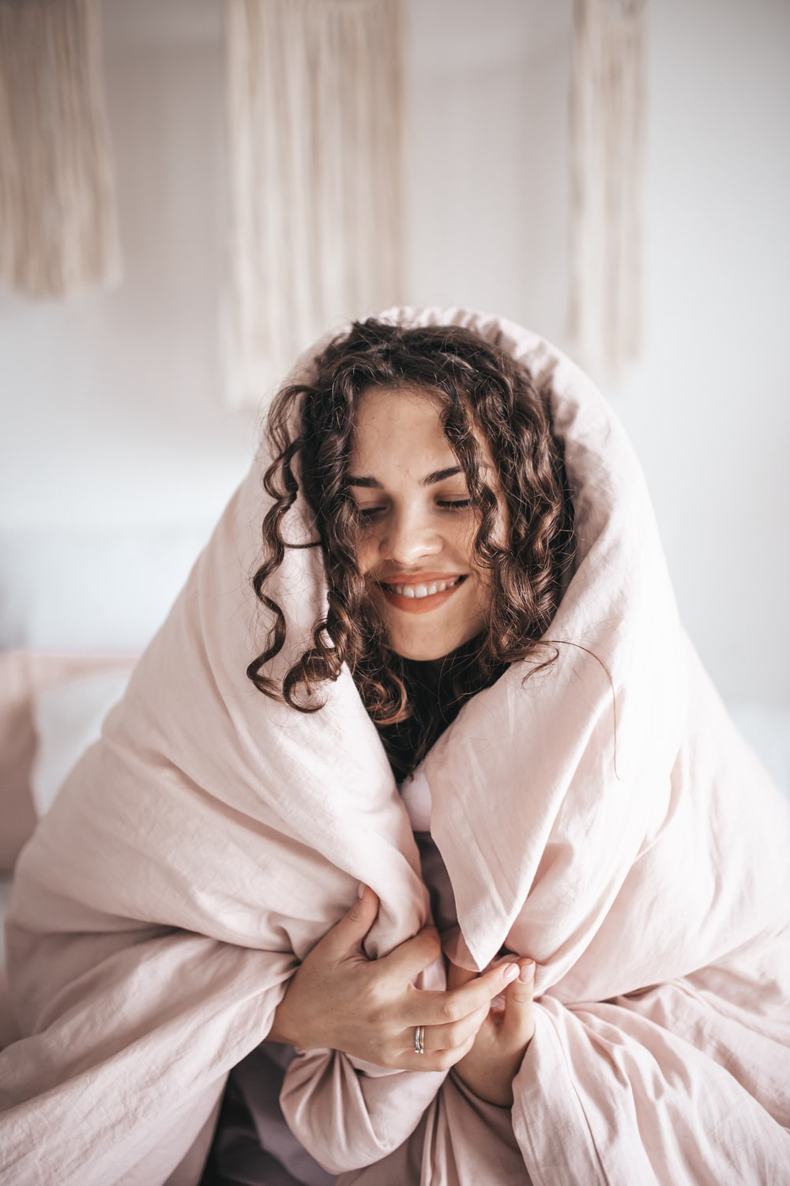

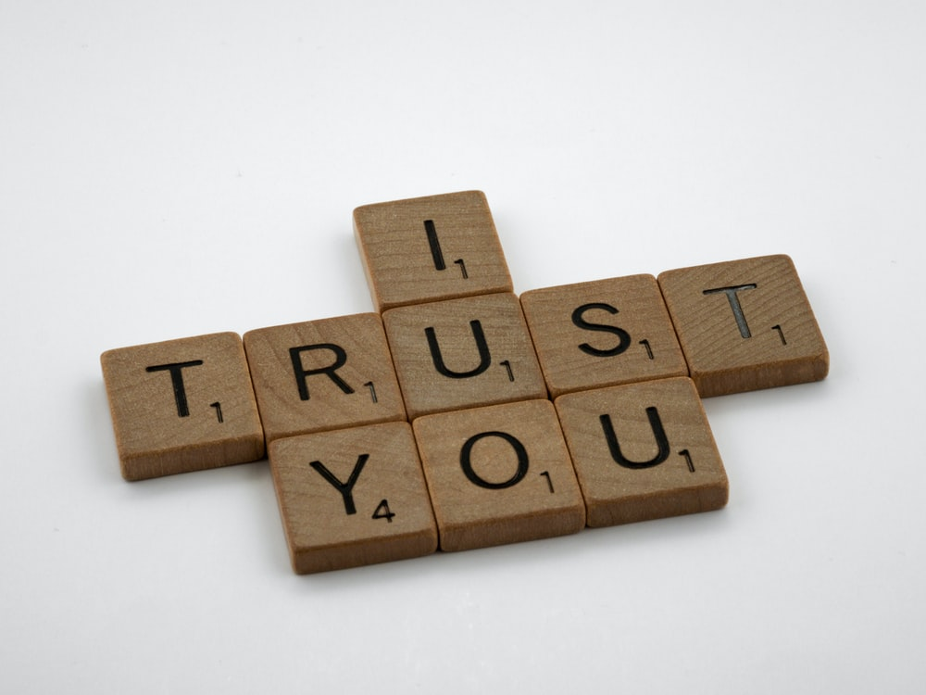
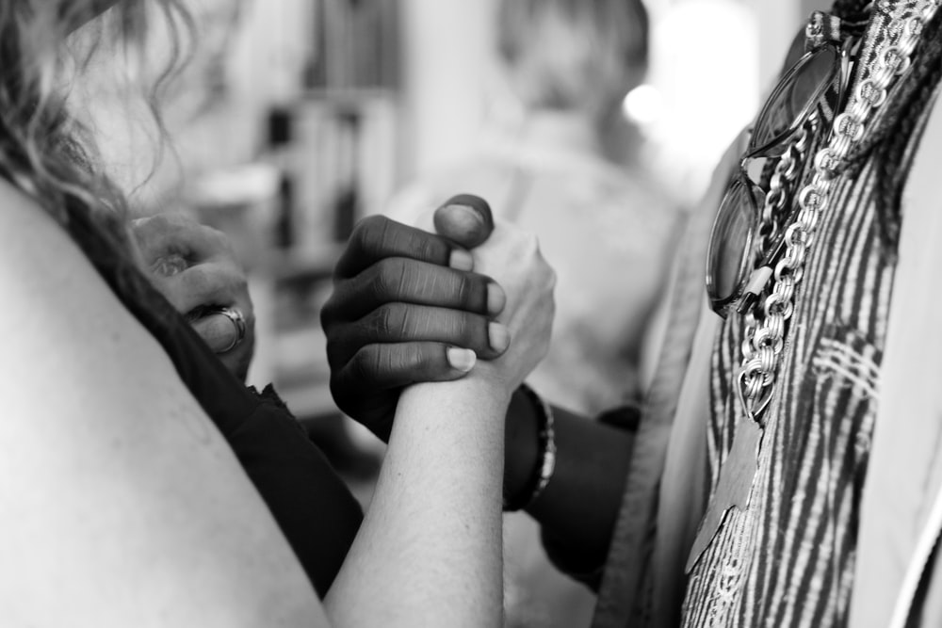
Inclusive communities foster collaboration
Respect
Trust
Recognition
Safety
Notes:
- Trust and safety
- Respect
- Recognition

Slide 12
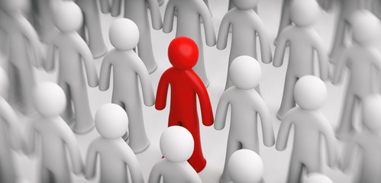
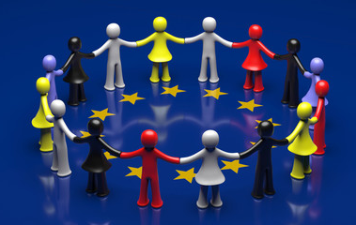
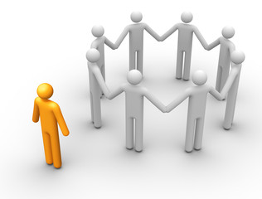
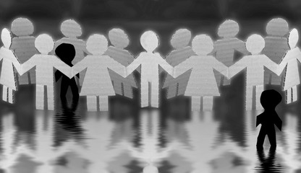
How to build belonging in your community
Low Belongingness
High Belongingness
High Value in Uniqueness
Differentiation
Inclusion
Low Value in Uniqueness
Exclusion
Assimilation
Shore, L.M., “Inclusion and Diversity in Work Groups”
Notes:
Graph from Inclusive Conversations by Mary-Frances Winters
To build belonging, you must recognize the individual.
- Be helpful
- Be respectful
- Be a consistent contributor. Post new stuff, answer questions
- Celebrate success!

Slide 13
Invite Business Unit Human Resources Consultant
[Highlight HR resources available for employees]
[Highlight Employee Resource Groups to show case affinity groups and how to join them ]
Notes:
Erin- I’d like to welcome Hannah Wiley, the DevRel People Consultant from People and Communities and have her introduce herself. Hannah will share best practices to access resources within the P&C communities. Thank you for joining Hannah

Slide 14
[Insert Survey QR Code]
OR
[Insert Survey URL and passcode]
What is your favourite team activity that fosters belonging, past or present?
Notes:
I'll hand it over to Jeff and Joanna address the last slido question

Slide 15
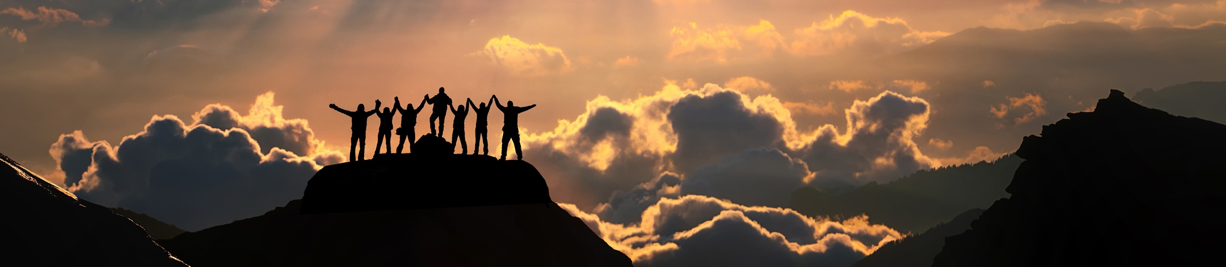
Our post-event activity
Host: Local Satellite Events Get-togethers
Team Meet up at local shops
Notes:
Ryan – San Jose, Erin- RTP, Northeast ? Texas? Host- Local get togethers across the globe for more in-person activities. Budget needed?
Create Guideline- go some place else besides your desk.
Post pictures
Timezone Virtual meet ups- for remote individuals
Template on “How to Host event”
Virtual Water Cooler
Storytelling/Sharing ie“Travel”/”Name”
Post event Series (informal)

Slide 16


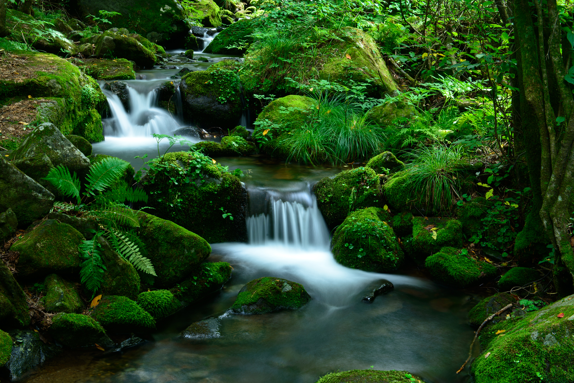
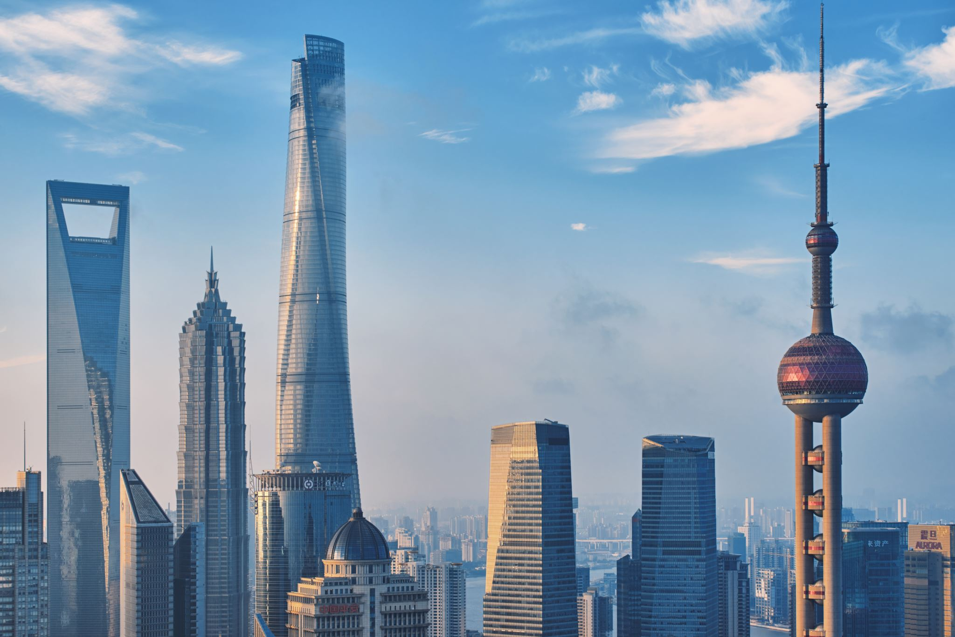

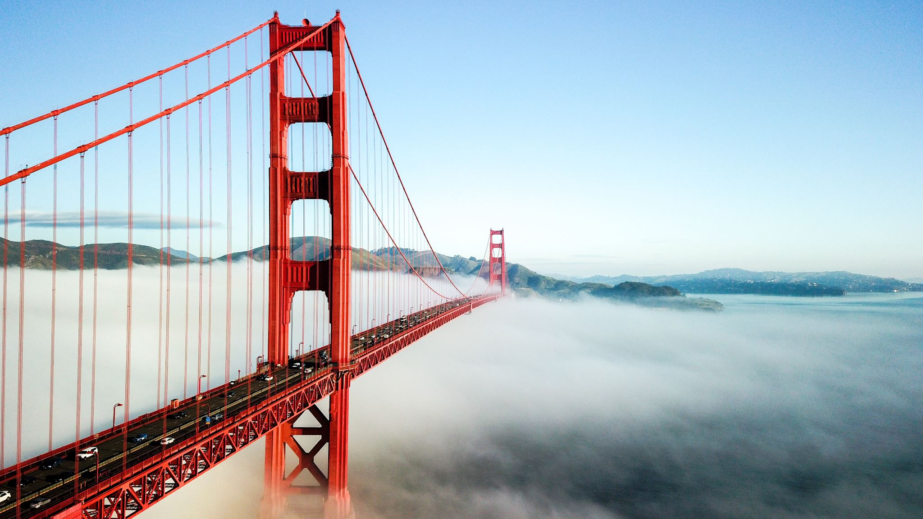
Local Meet-up, per your Geographical Location

Slide 17

[Helpful sites to know]
List helpful sites/resources that will be beneficial to create a sense of belonging
Notes:
As with many large corporations, there's a certain "Corporate lingo" that we n the workplace, so please reference the links listed here that may be helpful site even if you've been here for quite a while.
Cisco Acrononyms
Cisco Directory or CEC
There is Cisco Clueless webex rooms to answer a plethora of questions
And of course, visit our DevRel Team SharePoint.

Slide 18

Now Let’s Dance!
Thank You
[Insert Survey URL and passcode]
[Insert Survey QR Code]
OR
Notes:
Please go to Slido or scan the QR code to take the post-event survey for today’s session. We’d really love to hear from you. Now Let’s Dance.
Thank you again for joining today’s session. Have a great day!

